Slide 1
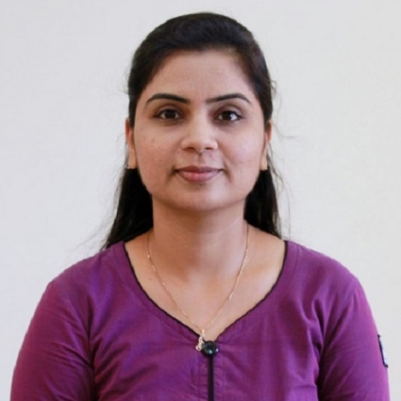
Unit – 5 Turing Machine
Theory of Computation (TOC)
DU # 2101CS603
Prof. Dixita B. Kagathara
Computer Engineering Department
dixita.kagathara@darshan.ac.in
+91 - 97277 47317 (CE Department)

Slide 2
Topics to be covered
What is Turing Machine?
Formal Definition: Turing Machine
Design of Turing Machine
Universal Turing Machine
Church Turing Thesis
Recursive Language & Recursively Enumerable language
Decidability and Undecidability
Halting Problem
Post‘s Correspondence Problem
Classification of complexity

Looping

Slide 3
Introduction to Turing Machine

Slide 4
Introduction to Turing Machine
Finite Automata
Input Strings
Pushdown Automata
Input Strings
Stack
Turing Machine
Input Strings
Tape
Special symbol
Control portion
a
b
a
a
Stack Control
I/p
Accept | Reject
Δ
a
b
a
a
b
Δ
Tape Head
TM
Stack
PDA
FA
Recursively enumerable language
Context free language
Regular language

Slide 5
Turing Machine
The tape is capable of performing following three operations:
Read a symbol above the tape head.
Modify/Update a symbol above the tape head.
Shifting either to previous square or next square.
b
a
a
b
a
Δ
b
Δ
Head

Slide 6






Turing Machine
$${ q}_{2}$$
$${ q}_{3}$$
$${ q}_{1}$$
$${ q}_{4}$$
Δ
b
a
a
b
a
Δ
Head
$${ q}_{5}$$
$${ q}_{6}$$
Tape
Control portion
Turing Machine = Control portion + Tape

Slide 7


Turing Machine
Operation to be performed by TM:
Read a symbol above the tape head.
Modify/Update a symbol above the tape head.
Shifting either to previous square or next square.
b
a
a
b
a
Δ
b
Δ
Head
Some other Ex:
b | a, L
Update
a | Δ, R
Read
Shift (L or R or S)
$${ q}_{0}$$
a | b, R
$${ q}_{1}$$
a | a, R
a | A, S

Slide 8
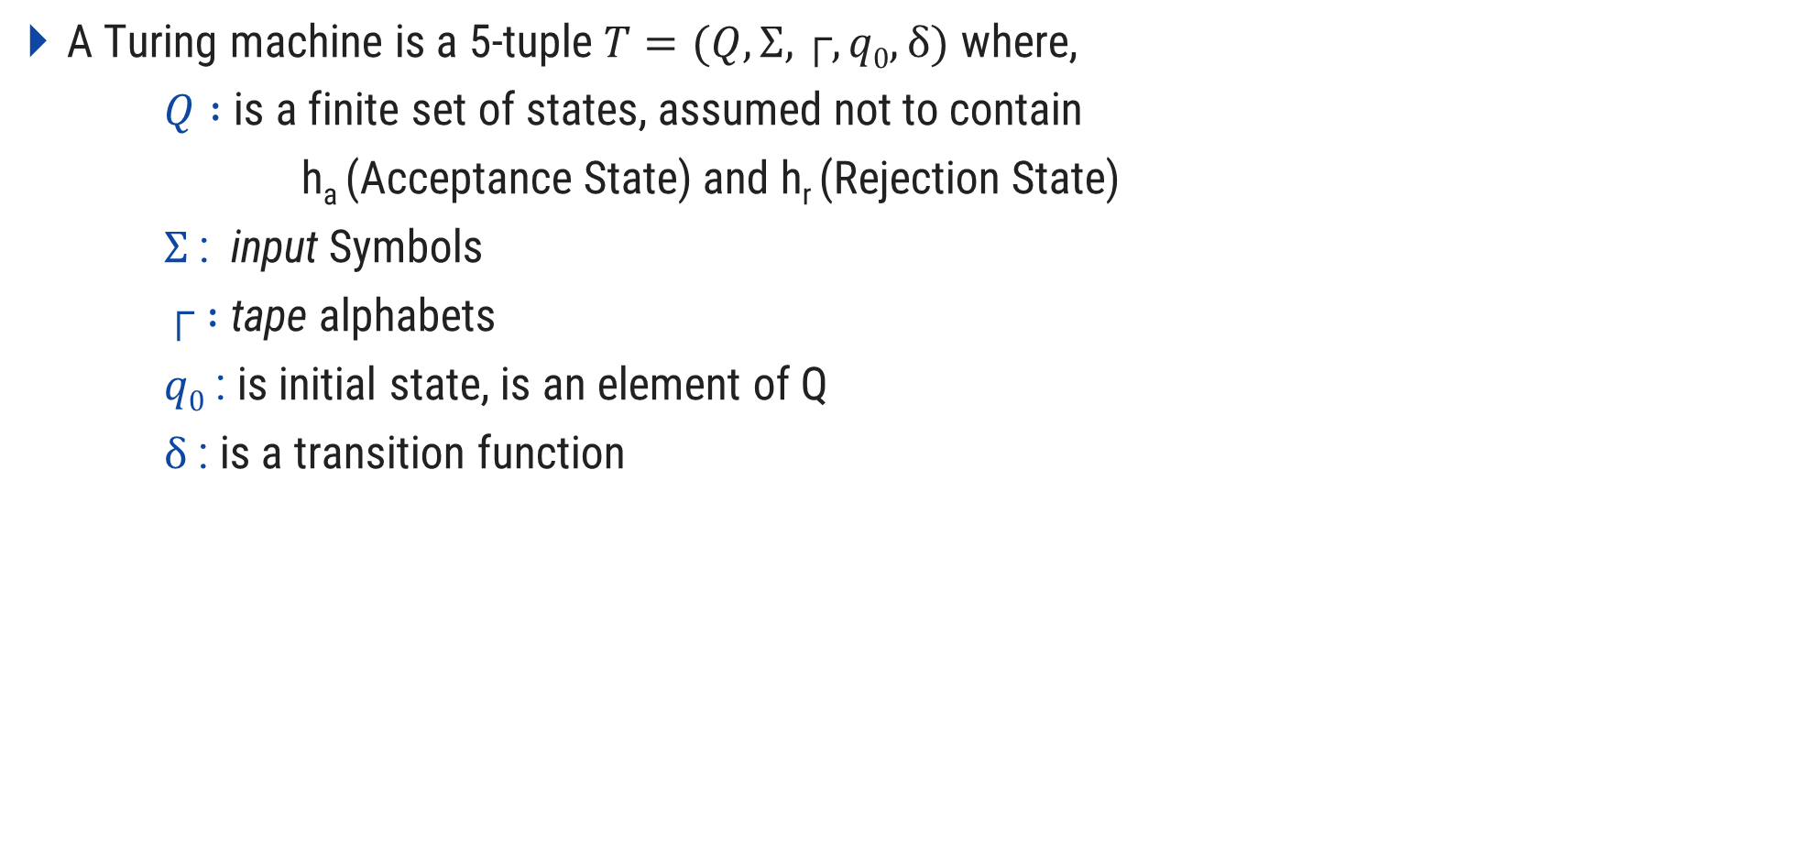
Definition: Turing Machine
A Turing machine is a 5-tuple $T=(Q,Σ,┌,q0,δ)$ where,
$Q :$is a finite set of states, assumed not to contain
h_{a} (Acceptance State) and h_{r} (Rejection State)
$Σ$: input Symbols
$┌ :$ tape alphabets
$q0$ : is initial state, is an element of Q
$δ$ : is a transition function

Slide 9
Turing Machine Accepting 𝑎𝑏∗𝑎
L = {ab*a}
Strings accepting in given L are:
aa
a b a
a b b a
a b b b a
Tape
a
a
Δ
A
b
Δ
B
A
A
b
a
a
B
B
Δ
Δ
b
A
Logic:
Read ‘a’, replace ‘a’ by ‘A’ (a→A)
Read all ‘b’ one by one & replace it by ‘B’ (b→B)
if no ‘b’ found: SKIP step 2
Read ‘a’, replace ‘a’ by ‘A’ (a→A)
A
a
Δ
a
A
Δ

Slide 10






Turing Machine Accepting $ab∗a$
Tape
a
a
Δ
A
b
Δ
B
A
$${ h}_{r}$$
b|B,R
a|A,R
b|B,R
b|B,R
$${ q}_{0}$$
Δ|Δ,R
$${ q}_{1}$$
a|A,R
$${ q}_{2}$$
a|A,R
$${ q}_{3}$$
Δ|Δ,S
$${ h}_{a}$$
Control portion

Slide 11
Turing Machine Accepting${ \{a}^{n}b^{n}| n≥1 \}$
L = {a^{n}b^{n}}
Strings accepting in given L are:
a b
a a b b
a a a b b b
Tape
a
A
B
A
a
b
B
Δ
b
Δ
Logic:
Read ‘a’, replace ‘a’ by ‘A’ (a→A)
Move RIGHT to first ‘b’
if none : REJECT
Replace ‘b’ by ‘B’ (b→B)
Move LEFT to leftmost ‘a’
Repeat the above steps until no more a’s
Make sure no more b’s remain.
a
a
A
B
A
A
a
b
b
b
Δ
B
B
Δ

Slide 12






Turing Machine Accepting${ \{a}^{n}b^{n}| n≥1 \}$
A
a
A
B
a
b
Δ
B
b
Δ
B/B,R
B/B,L
a/a,R
a/a,L
$${ q}_{0}$$
Δ/Δ,R
$${ q}_{1}$$
a/A,R
$${ q}_{2}$$
b/B,L
$${ q}_{3}$$
B/B,R
A/A,R
$${ q}_{4}$$
B/B,R
Δ/Δ,S
$${ h}_{a}$$

Slide 13








Turing Machine Accepting${ \{a}^{n}b^{n}c^{n}| n≥0 \}$
a/a,R
b/b,R
C/C,L
B/B,R
C/C,R
a/a,L
a
a
c
$${ q}_{2}$$
b/B,R
$${ q}_{3}$$
c/C,L
$${ q}_{4}$$
b/b,L
B/B,L
A
b
B
c
Δ
A
B
b
C
C
Δ
a/A,R
A/A,R
$${ q}_{0}$$
Δ/Δ,R
$${ q}_{1}$$
Δ/Δ,S
$${ h}_{a}$$
B/B,R
$${ q}_{5}$$
C/C,R
Δ/Δ,S
$${ q}_{6}$$
B/B,R
C/C,R

Slide 14
Turing Machine Accepting $\text{Palindrome} \text{strings} \text{of} \text{E}\text{ven}\text{ \& }\text{O}\text{dd} \text{length}$
L = Palindrome string
Strings accepting in given L are:
a a
b a b
a b b a
b a b a b
Tape
Δ
b
Δ
Δ
b
Δ
a
Δ
a
Δ
Even Length
Δ
a
Δ
b
Δ
b
Δ
a
b
Δ
Δ
Δ
Logic:
Read leftmost symbol , replace it with Δ
Keep moving to the right until the rightmost symbol,
If matched with leftmost symbol then replace it with Δ
Otherwise : REJECT the String
Repeat the above steps until no more symbol left in string.
Odd Length

Slide 15








Turing Machine Accepting $\text{Palindrome} \text{strings} \text{of} \text{E}\text{ven}\text{ \& }\text{O}\text{dd} \text{length}$
a/a,R
b/b,R
Δ/Δ,R
(odd pal)
Δ
Δ
Δ
Δ
Δ
a
b
b
a
Δ
$${ q}_{2}$$
Δ/Δ,L
$${ q}_{3}$$
a/a,L
b/b,L
a/Δ,R
a/Δ,L
$${ q}_{0}$$
Δ/Δ,R
$${ q}_{1}$$
Δ/Δ,R
$${ q}_{4}$$
$${ h}_{a}$$
b/Δ,R
b/Δ,L
Δ/Δ,L
Δ/Δ,R
$${ q}_{5}$$
$${ q}_{6}$$
(odd pal)
a/a,R
b/b,R
Δ/Δ,R
(even pal)

Slide 16








String Tracing
a/a,R
b/b,R
Δ/Δ,R
(odd pal)
├ (q₀,△ a a)
├ (q₁,△ a a)
$${ q}_{2}$$
Δ/Δ,L
$${ q}_{3}$$
├ (q₂,△ △ a )
a/a,L
b/b,L
├ (q₂,△ △ a △ )
a/Δ,L
a/Δ,R
├ (q₃,△ △ a )
$${ q}_{0}$$
Δ/Δ,R
$${ q}_{1}$$
Δ/Δ,R
$${ q}_{4}$$
$${ h}_{a}$$
├ (q₄,△ △ )
├ (q₁,△ △ △)
├ (h_{a}, △ △ △ △)
b/Δ,R
b/Δ,L
Accept
Δ/Δ,L
Δ/Δ,R
$${ q}_{5}$$
$${ q}_{6}$$
(odd pal)
a/a,R
b/b,R
Exercise
aba
abab
Δ/Δ,R
(even pal)

Slide 17
TM Accepting same no of 0’s and 1’s
L = Same no. of 0’s and 1’s
Strings accepting in given L are:
01
10
0101
1100
100011
Δ
x
x
1
0
x
x
0
1
Δ
x
0
1
x
x
Δ
x
x
0
1
0
x
1
Δ
Logic:
Move right, Read first leftmost 0, replace 0 with X (0→X)
Keep moving to the left until you encounter Δ
Move right, Read first leftmost 1, replace 1 with X (1→X)
Keep moving to the left until you encounter Δ
Repeat the above steps until no more 0’s and 1’s left in string.

Slide 18







TM Accepting same no of 0’s and 1’s
X
0
0
1
Δ
1
X
X
X
Δ
1/1,R
x/x,L
x/x,R
x/x,L
x/x,R
1/1,L
0/0,R
0/0,L
Δ/Δ,R
$${ q}_{0}$$
$${ q}_{1}$$
0/x,L
$${ q}_{2}$$
Δ/Δ,R
$${ q}_{3}$$
1/x,L
$${ q}_{4}$$
Δ/Δ,L
Δ/Δ,R
$${ q}_{5}$$
Δ/Δ,S
$${ h}_{a}$$
x/x,L

Slide 19









TM Accepting same no of a’s, b’s & c’s
a
X
X
X
X
c
b
b
c
a
X
Δ
X
Δ
x/x,R
b/b,R
c/c,R
x/x,L
b/b,L
c/c,L
x/x,R
a/a,R
c/c,R
x/x,L
a/a,L
c/c,L
x/x,R
b/b,R
a/a,R
x/x,L
b/b,L
a/a,L
$${ q}_{0}$$
Δ/Δ,R
$${ q}_{1}$$
a/x,L
$${ q}_{2}$$
Δ/Δ,R
$${ q}_{3}$$
b/x,L
$${ q}_{4}$$
Δ/Δ,R
$${ q}_{5}$$
c/x,L
$${ q}_{6}$$
Δ/Δ,L
Δ/Δ,R
$${ q}_{7}$$
Δ/Δ,S
$${ h}_{a}$$
x/x,L

Slide 20
Turing machine to delete a symbol
ΔaabΔ
Δ
a
Δ
a
b
Δ
b
Logic:
Replace the symbol you want to delete by Δ.
Keep moving to the Right until you encounter Δ.
One by one Keep shifting every symbol one step to left until you encounter Δ.

Slide 21






Turing machine to delete a symbol
a/a,L
a
Δ
a
b
a
Δ
Δ
b
b
Δ
$${ q}_{3}$$
a/a,R
b/b,R
a/Δ,R
Δ/Δ,R
a/Δ,L
Δ/a,S
$${ q}_{0}$$
b/Δ,R
$${ q}_{1}$$
Δ/Δ,L
$${ q}_{2}$$
$${ h}_{a}$$
b/a,L
a/b,L
b/Δ,L
Δ/b,S
$${ q}_{4}$$
Δ/Δ,S
b/b,L

Slide 22
Turing machine to copy a string
String:
Δ ab
Δ bab
Δ
a
a
b
a
Δ
A
B
Δ
Δ
b
Δ
b
Δ ab
Original
Pasted
Δ bab
a
a
b
a
A
B
a
Δ
b
a
b
Δ
b
A
Δ
Δ
Δ
Δ
Δ
b
Original
Pasted
b
B
a

Slide 23










Turing machine to copy a string
a/a,R
a/a,R
b/b,R
b/b,R
a
b
a
b
Δ
Δ
Δ
a
B
Δ
Δ
A
b
$${ q}_{2}$$
Δ/Δ,R
$${ q}_{3}$$
a/a,L
Δ/a,L
a/a,L
b/b,L
b/b,L
a/A,R
$${ q}_{0}$$
Δ/Δ,R
$${ q}_{1}$$
$${ q}_{4}$$
Δ/Δ,L
$${ q}_{5}$$
Δ/Δ,L
b/B,R
Δ/b,L
$${ h}_{a}$$
Δ/Δ,S
$${ q}_{8}$$
$${ q}_{6}$$
Δ/Δ,R
$${ q}_{7}$$
a/a,R
a/a,R
b/b,R
b/b,R
A/a,L
A/A,R
B/b,L
B/B,R

Slide 24
Design a TM for Accepting {SS | S ∈ {a,b}*}
Logic:
Find middle point of the string and convert the string in to the uppercase.
Convert first part of the string to lowercase.
Compare first part and second part.

Slide 25











A|A,R
B|B,R
Design a TM for Accepting {SS | S ∈ {a,b}*}
a|a,R
b|b,R
Find middle point of the string
a|a,L
b|b,L
$${ q}_{0}$$
Δ|Δ,R
$${ q}_{1}$$
a|A,R
b|B,R
$${ q}_{2}$$
A|A,L
B|B,L
Δ|Δ,L
$${ q}_{3}$$
a|A,L
b|B,L
$${ q}_{4}$$
A|A,L
B|B,L
Δ|Δ,S
Convert first part to lower case
A|a,L
B|b,L
$${ q}_{5}$$
$${ h}_{a}$$
Δ|Δ,R
Δ|Δ,S
$${ q}_{6}$$
Compare first and second part
b|B,R
a|A,R
a|a,R
b|b,R
Δ|Δ,R
A|A,R
B|B,R
a|a,R
b|b,R
Δ|Δ,R
$${ q}_{7}$$
$${ q}_{8}$$
B|Δ,L
A|Δ,L
$${ q}_{9}$$
a|a,L
b|b,L
Δ|Δ,L

Slide 26
Universal Turing machine

Slide 27
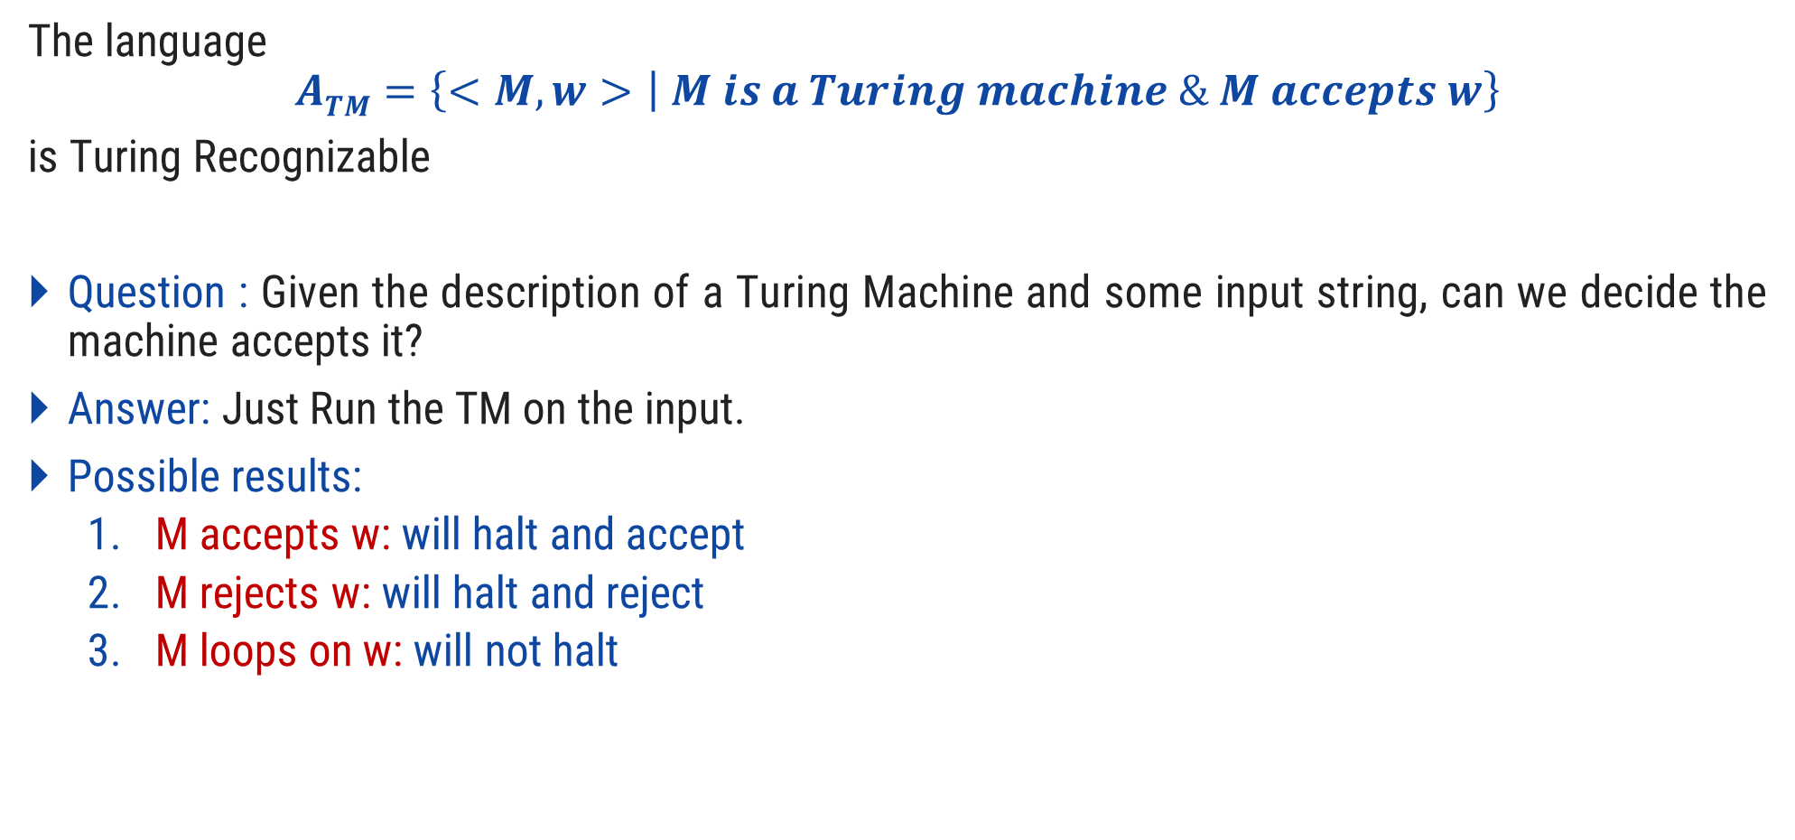
Universal Turing machine
The language
$$ATM=\left\{<M, w> | M is a Turing machine \& M accepts w\right\}$$
is Turing Recognizable
Question : Given the description of a Turing Machine and some input string, can we decide the machine accepts it?
Answer: Just Run the TM on the input.
Possible results:
M accepts w: will halt and accept
M rejects w: will halt and reject
M loops on w: will not halt

Slide 28

Universal Turing machine
Input:
M=description of TM
w=input string for M
Action:
Simulate M
Behave just like M (May accept, reject or loop)
The UTM is recognizer for
$$ATM=\left\{<M, w> | M is a Turing machine and M accepts w\right\}$$

Slide 29
Church Turing Thesis

Slide 30
Church Turing Thesis
What does computable mean?
Meaning of term Computable was given by:
Alonzo church (Lambda calculus)
Allen Turing (Turing Machine)
Any algorithmic procedure that can be carried out at all, by a human computer or a team of humans or an electronic computer, can be carried out by a TM. This statement usually referred to as Church’s thesis, or the Church-Turing thesis.

Slide 31
Church Turing Thesis
Here is an informal summary of some of the evidence.
Humans normally work with a two-dimensional sheet of paper. A TM tape could be organized so as to simulate two dimensions; one likely consequence would be that the TM would require more moves to do what a human could do in one.
Various enhancements of the TM model have been suggested to make the operation more like that of a human computer, or more convenient & efficient. The multitape TM is an example.
Other theoretical models includes abstract machines with two stacks or with a queue.
Since the introduction of the Turing machine, no one has suggested any type of computation that ought to be included in the category of “algorithmic procedure” and cannot be implemented on a TM.

Slide 32
Recursive Language & Recursively Enumerable language

Slide 33
Recursive Language & Recursively Enumerable language
Recursive Language
A language L is said to be recursive if there exist a Turing machine which will accept all the strings in L and reject all the strings not in L.
The Turing machine will halt every time and given an answer (accept or reject) for each and every string input.
Recursively Enumerable Language
A language L is said to be recursively enumerable language if there exists a Turing machine which will accept (and there for halt) for all the input strings which are in ‘L’.
But may or may not halt for all input strings which are not in ‘L’.

Slide 34
Decidability and Undecidability

Slide 35
Decidability and Undecidability
Decidable language
A language L is decidable if it is a recursive language. All decidable languages are recursive languages and vice-versa.
Partially decidable language
A language ‘L’ is partially decidable if ‘L’ is a recursively enumerable language.
Undecidable Language
A language is undecidable if it is not decidable.
An undecidable language may sometimes be partially decidable but not decidable.
If a language is not even partially decidable, then there exists no Turing machine for that language.

Slide 36
Summary
Recursive Language | TM will always halt
Recursively Enumerable Language | TM will halt sometime & may not halt some times
Decidable Language | Recursive language
Partially decidable Language | Recursively Enumerable language
UNDECIDABLE | No TM for that Language

Slide 37
Halting Problem

Slide 38
Example: Undecidability (Halting Problem)
Given a program, will it halt?
Given some program written in some language(java/c) will it ever get into an infinite loop or will it always terminate?
Answers:
In general we can’t always know.
The best we can do is run the program and see whether it halts.
For many programs we can see that it will halt or sometimes goes into the loop.
Can we design a machine which if given a program can find out or decide if that program will always halt on a particular input?

Slide 39
Post‘s Correspondence Problem

Slide 40
Post‘s Correspondence Problem
The post correspondence problem is an undecidable decision problem introduced by Email post in 1946.
Example 1:
B
CA
A
AB
CA
A
ABC
C
A
AB
B
CA
CA
A
A
AB
ABC
C
A B C A A A B C
A B C A A A B C

Slide 41
Post‘s Correspondence Problem
Example 2:
10
101
 | A | B
1 | 10 | 101
2 | 011 | 11
3 | 101 | 011
011
11
10101101101…..
101011011011….
101
011

Slide 42
Post‘s Correspondence Problem
Example 3:
Find whether the lists M = (ab, bab, bbaaa) and N = (a, ba, bab) have a Post Correspondence Solution?
Solution
In this case, there is no solution because −| x₂x₁x₃ | ≠ | y₂y₁y₃ | (Lengths are not same)
Hence, it can be said that this Post Correspondence Problem is undecidable.
 | x₁ | x₂ | x₃
M | ab | bab | bbaaa
N | a | ba | bab

Slide 43
Classification of complexity

Slide 44
P Problem
P-Class
the P class stands for Polynomial Time.
It is the collection of decision problems (problems with a “yes” or “no” answer) that can be solved by a deterministic machine in polynomial time.
These problems can be solved in time O(n^{k}) in worst-case, where k is constant.

Slide 45
NP Problem
NP-Class
NP class stands for Non-deterministic Polynomial Time.
It is the collection of decision problems that can be solved by a non-deterministic machine in polynomial time.
The solutions of the NP class are hard to find since they are being solved by a non-deterministic machine but the solutions are easy to verify.
Problems of NP can be verified by a Turing machine in polynomial time.
NP
P

Slide 46
NP Hard problem
The problems which can not be solve in polynomial time.
There is no known polynomial time solution.

Slide 47
NP Complete Problem
NP complete is NP hard as well as NP.
It is not solvable in polynomial time but, if solution of problem is given then, it can be verified in polynomial time.
NP
NP Hard
P
NP Complete

Slide 48
Thank You

